Slide 1
DNS Concepts

Slide 2
Agenda
What is a hosted zone?
DNS Query.
Alias record.
Subdomain.
Name servers.
Private DNS.
DNS resolver.

Slide 3
Hosted Zone
Information about how traffic for a certain domain and its subdomains should be routed.
Public hosted zone:
Indicate how we want internet traffic to be routed.
Private hosted zone:
Contain data that indicate how traffic should be routed.

Slide 4

DNS Query
To the Domain Name System (DNS) by a device, such as a computer or a smartphone.
User opens a browser and type the domain name into the address bar.
Often returned in response to a DNS query.
Use the browser and search we make a DNS query.

Slide 5
Alias record
Redirects our domain name to a hostname rather than an IP address.
When we want the domain and not the subdomain to “point” to a hostname.
Amazon CloudFront distributions.
Amazon S3 using Amazon Route 53.

Slide 6
Subdomain
One or more labels prefixed to it when it is registered.
Create a record with the desired name, and the appropriate values, such as a web server's IP address.

Slide 7
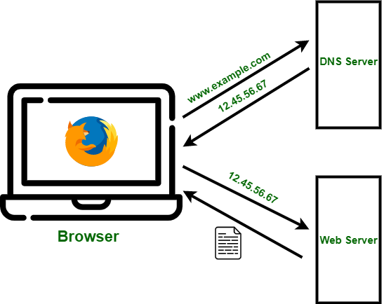
Name Servers
Translation of domain names into IP addresses that computers use to communicate.
Authoritative name servers are the two types of name servers.

Slide 8
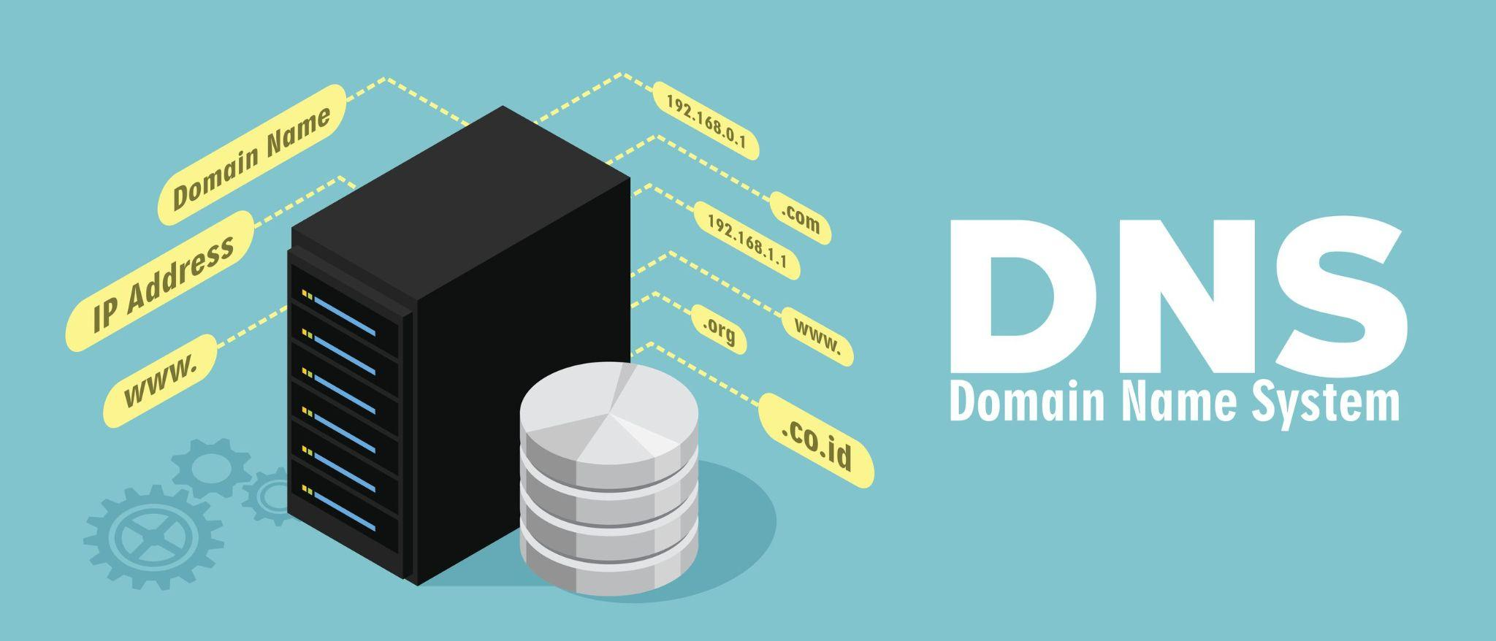
Private DNS
Allows us to route traffic for a domain.
To Amazon EC2 instances in one or more Amazon virtual private clouds (VPCs).

Slide 9
DNS resolver
User requests and DNS name servers.
Resolver connects with DNS name servers.
It receives a response usually in the form of an IP address.
Delivers to the user's device.

